Slide 1
Link Analysis (Part II)
Prof. Wei-Min Shen
University of Southern California
With slide contributions from
J. Leskovec, Anand Rajaraman, Jeffrey D. Ullman

Slide 2
OUTLINE
Link Analysis (Part II)
Solving the flow model: Mv = v
Power Iteration and Gaussian Elimination
Dead-ends and spider traps (teleporting and taxation)
PageRank for Search Engines (MapReduce)
Topic-specific: (augment for general-popularity)
Trust-Rank: (fighting against link spams)
Hubs-and-Authorities: (multiple importances)

Slide 3
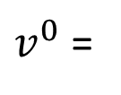
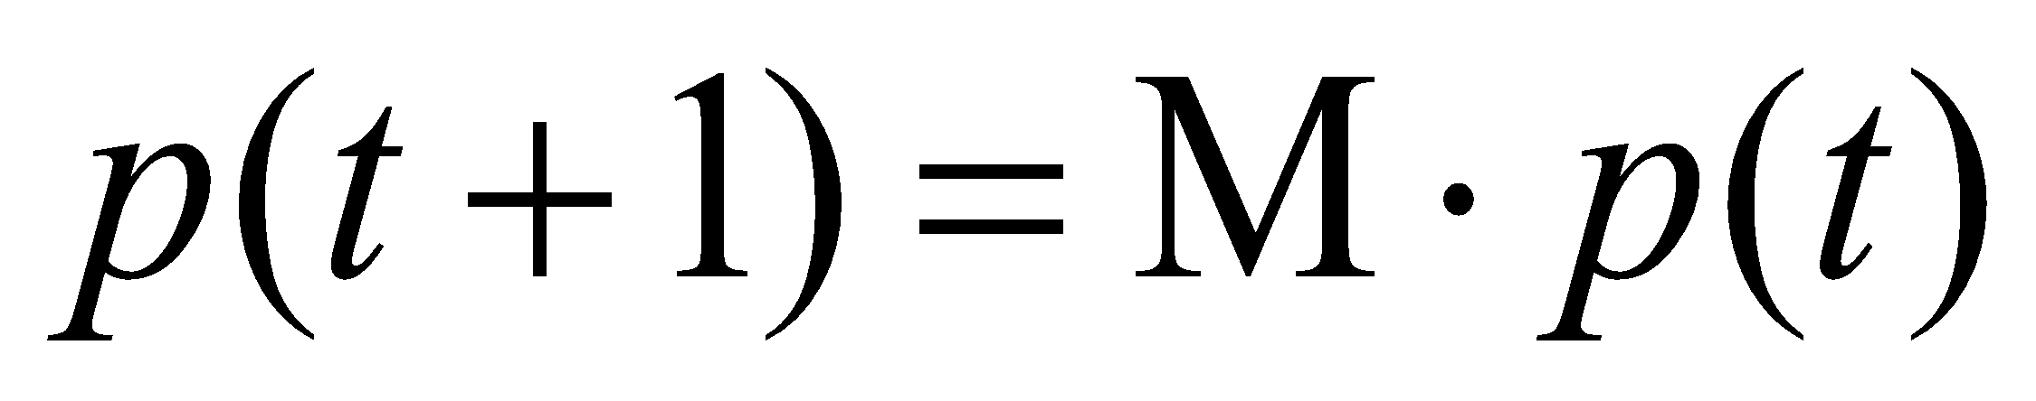
The Stationary Distribution
i₁
i₂
i₃
j
A central result from the theory of random walks (a.k.a. Markov processes):
For graphs that satisfy certain conditions, the stationary distribution is unique and eventually will be reached no matter what the initial probability distribution at time t = 0

Slide 4
SPIDER TRAPS AND DEAD-ENDS

Slide 5
PageRank: Problems
Two problems:
(1) Some pages are dead ends (have no out-links)
Random walk has “nowhere” to go to
Such pages cause importance to “leak out”
(2) Spider traps: (all out-links are within the group)
Random walked gets “stuck” in a trap
And eventually spider traps absorb all importance
Dead end
Spider trap

Slide 6
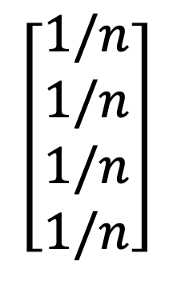

Problem: Spider Traps
 | y | a | m
y | ½ | ½ | 0
a | ½ | 0 | 0
m | 0 | ½ | 1
y
All outlinks are within a group
a
m
m is a spider trap
M
r_{y} = r_{y} /2 + r_{a} /2
r_{a} = r_{y} /2
r_{m} = r_{a} /2 + r_{m}
r^{k+1} = Mr^{k}
Iteration 0, 1, 2, …
All the PageRank score gets “trapped” in node m

Slide 7
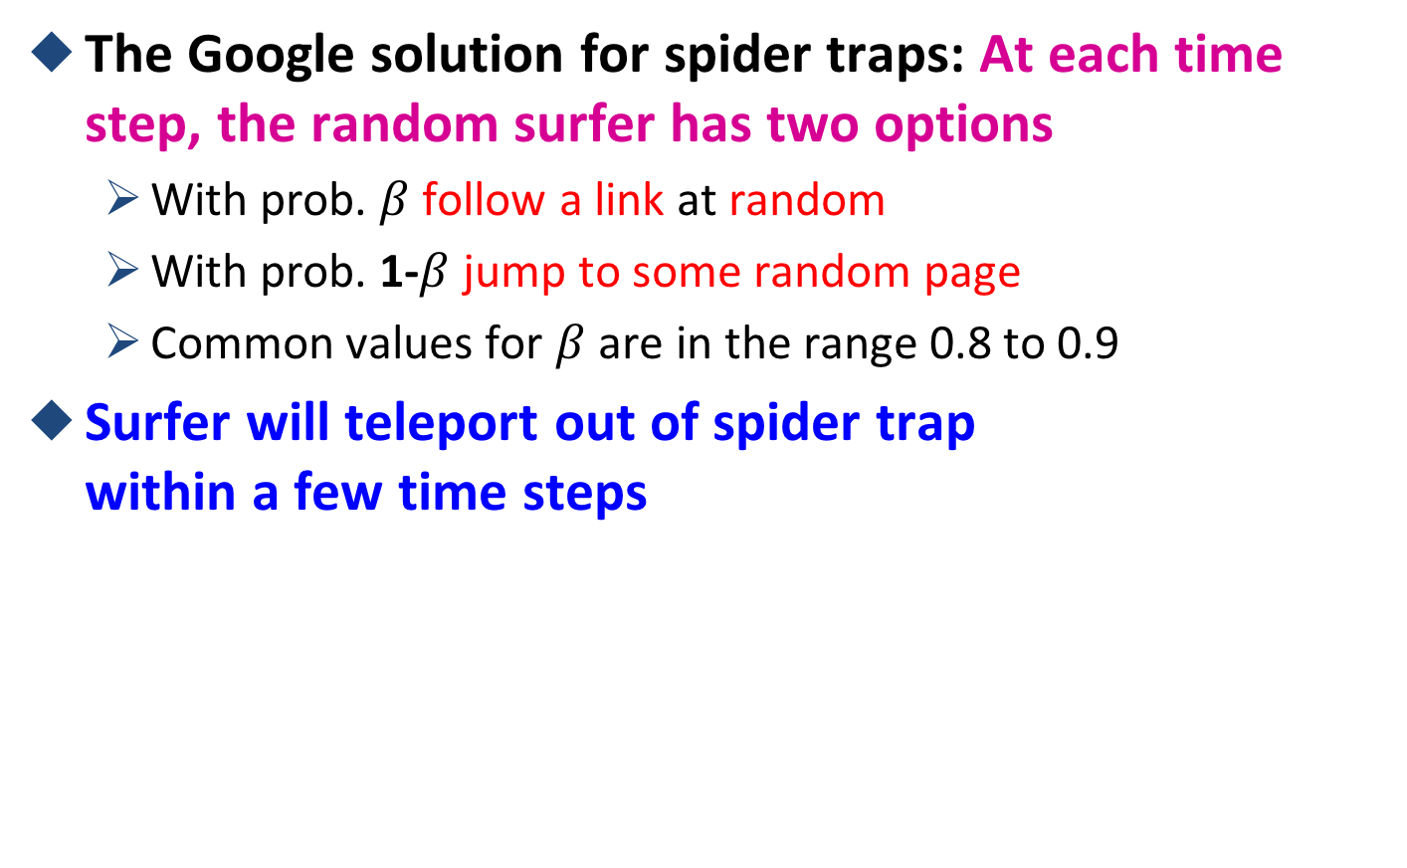
Solution: Teleports!
y
y
a
a
m
m

Slide 8
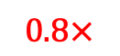
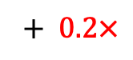
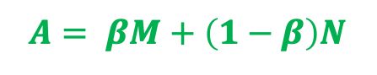
Random Teleports (β = 0.8)
M
[1/N]_{NxN}
7/15
y
1/2 1/2 0
1/2 0 0
0 1/2 1
1/3 1/3 1/3
1/3 1/3 1/3
1/3 1/3 1/3
7/15
1/15
7/15
1/15
y a m
13/15
y 7/15 7/15 1/15
a 7/15 1/15 1/15
m 1/15 7/15 13/15
a
7/15
m
1/15
1/15
r^{k+1} = Ar^{k}
r_{y}
r_{a} =
r_{m}
1/3
1/3
1/3
0.33
0.20
0.46
0.28
0.20
0.52
0.26
0.18
0.56
7/33
5/33
21/33
. . .

Slide 9
Matrix Formulation
Suppose there are N pages
Consider a page j, with set of outlinks O(j)
We have M_{ij} = 1/|O(j)| when j->i and M_{ij} = 0 otherwise
The random teleport is equivalent to
adding a teleport link from j to every other page with probability (1-β)/N
reducing the probability of following each outlink from 1/|O(j)| to β/|O(j)|
Equivalent: tax each page a fraction (1-β) of its score and re-distribute evenly
In some sense, “taxation” enables “teleporting”
But not the other way around

Slide 10
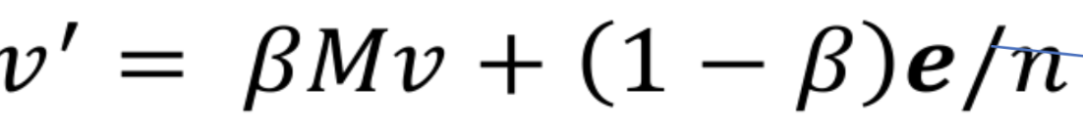
Taxation
Deal with spider traps and dead ends
By allowing surfer to jump to a random page
This jumping is also called “teleporting”
β, damping factor, e.g., set to 80%
e, an n-dimensional vector with all 1’s
n, # of nodes in the graph
This in effect makes graph “strongly-connected”
Tax: 20%
Distribute it evenly

Slide 11
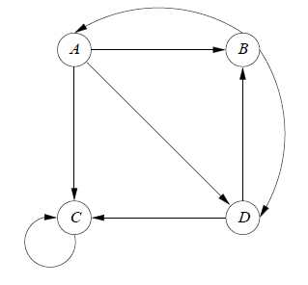
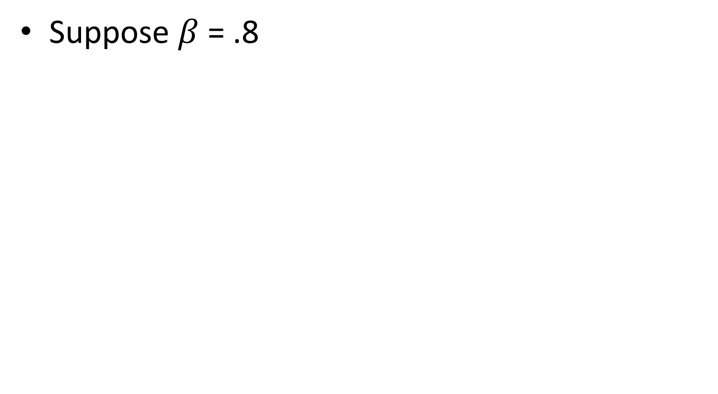
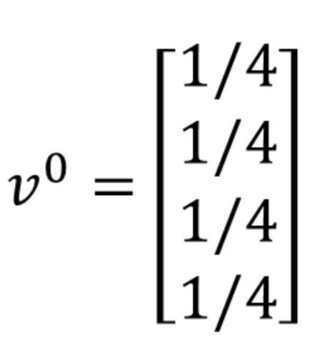
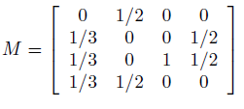
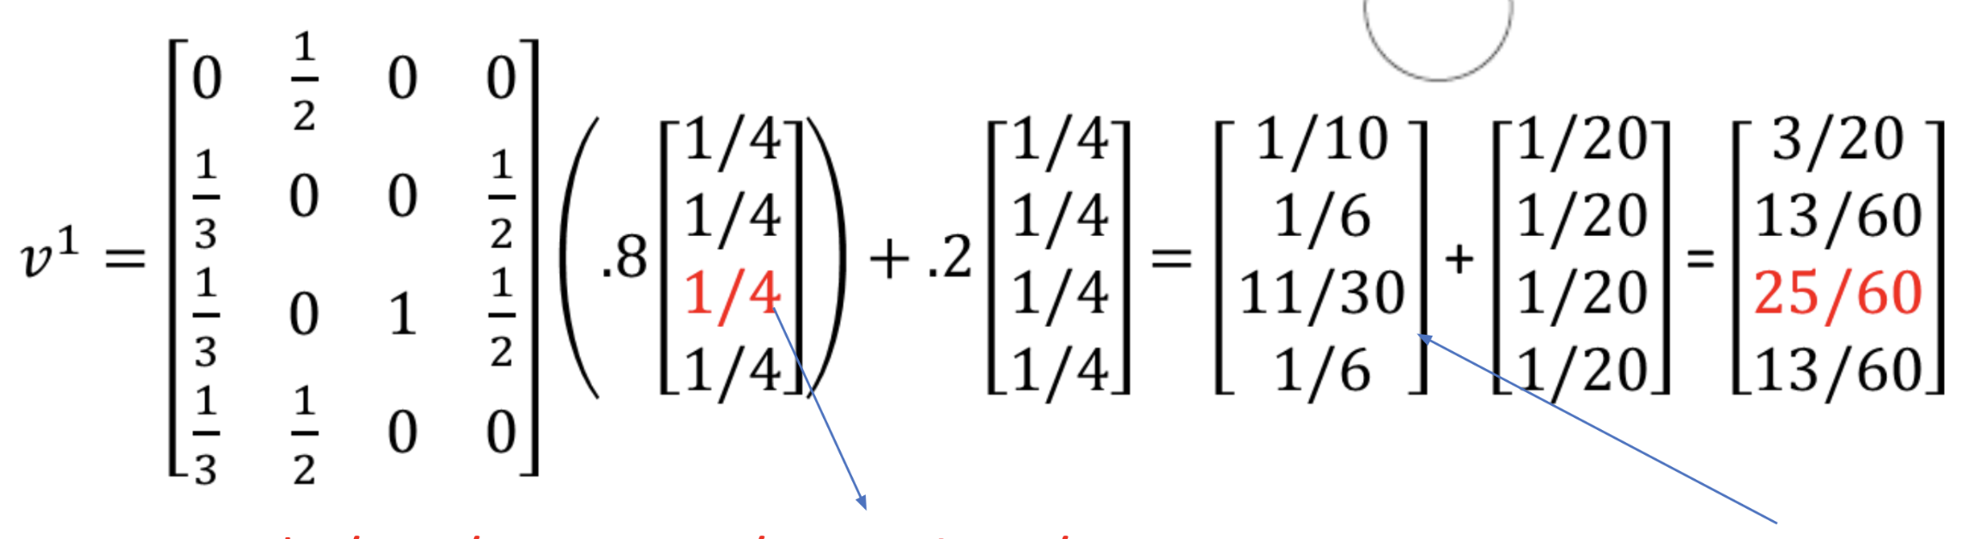
Taxation on Spider Trap
C=0.8*1/4=1/5; A, D = 1/6; total=11/30
(A and D:.8*1/4*(1/3+1/2)=1/6; C:.8*1/4=1/5)
Notes:
.8*1/4*(1/3+1/2)=8/10*1/4*5/6=1/5*5/6=1/6
0.8*(1/12 + ¼ + 1/8) = 0.8* (2/24 + 6/24 + 3/24) = 0.8 * 11/24 = 4/5 * 11/24 = 1/5 * 11/6 = 11/30

Slide 12
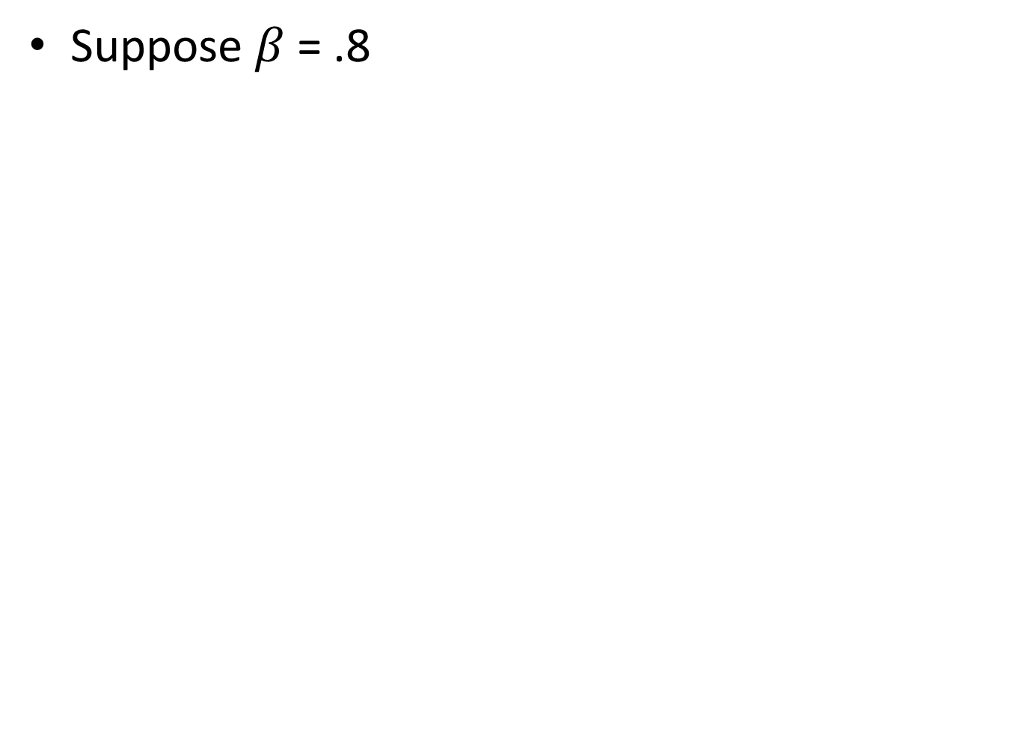
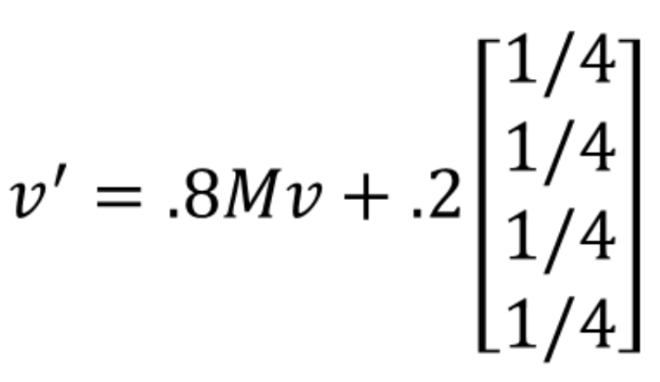
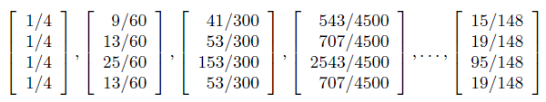
A
D
.8(1/3 * 15/148 + 95/148 +1/2 * 19/148) + .2 * 1/4 = 95/148
.8(1/3 * 15/148 + 1/2 * 19/148) + .2 * 1/4 = .2 * 95/148
A
D
80% of contribution from A and D + 20% of contribution from teleport
= 20 % of C’s rank

Slide 13
A | C | D | .8(1/3 A) | .8(1/2 D) | .8C | .2 * 1/4 | Next C
1/4 | 1/4 | 1/4 | 1/15 | 1/10 | 1/5 | 1/20 | 25/60 (.4)
9/60 | 25/60 | 13/60 | 3/75 | 13/150 | 1/3 | 1/20 | 153/300 (.5)
… | … | … | … | … | … | … | …
15/148 | 95/148 | 19/148 | 4/148 | 19/370 | 76/148 | 1/20 | 95/148 (.64)
decreasing
decreasing
increasing
Fixed
(teleport)
increasing

Slide 14
A | C | D | .8(1/3 A) | .8(1/2 D) | .8C | .2 * 1/4 | Next C
1/4 | 1/4 | 1/4 | 1/15 | 1/10 | 1/5 | 1/20 | 25/60 (.4)
9/60 | 25/60 | 13/60 | 3/75 | 13/150 | 1/3 | 1/20 | 153/300 (.5)
… | … | … | … | … | … | … | …
15/148 | 95/148 | 19/148 | 4/148 | 19/370 | 76/148 | 1/20 | 95/148 (.64)
decreasing
decreasing
increasing
fixed
increasing

Slide 15
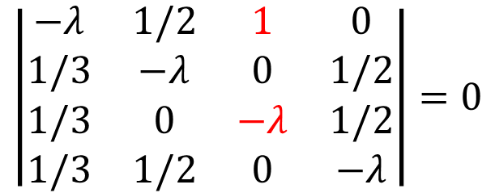
Problem: Dead Ends
 | y | a | m
y | ½ | ½ | 0
a | ½ | 0 | 0
m | 0 | ½ | 0
y
Pages with no outlinks are “dead ends” for the random surfer:
Nowhere to go on next step
a
m
r_{y} = r_{y} /2 + r_{a} /2
r_{a} = r_{y} /2
r_{m} = r_{a} /2
r^{k+1} = Ar^{k}
Here the PageRank “leaks” out since the matrix is not column stochastic (not all columns total to 1)

Slide 16
Solution 1 for Dead Ends: Always Teleport!
Teleports: Follow random teleport links with probability 1.0 from dead-ends
Adjust matrix accordingly
y
y
a
m
a
m
 | y | a | m
y | ½ | ½ | 0
a | ½ | 0 | 0
m | 0 | ½ | 0
 | y | a | m
y | ½ | ½ | 1/3
a | ½ | 0 | 1/3
m | 0 | ½ | 1/3

Slide 17
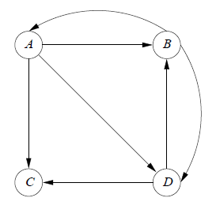
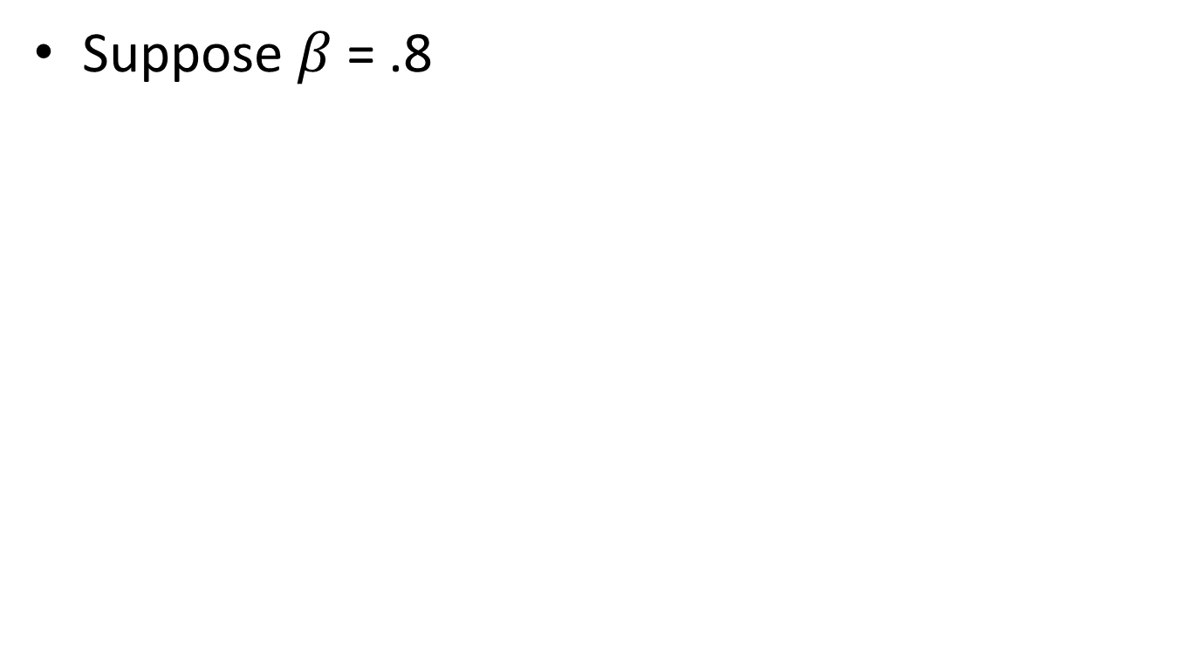
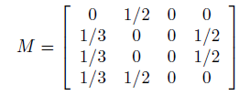
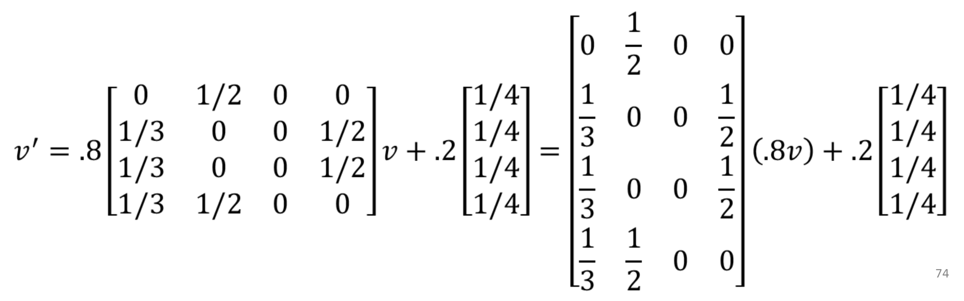
Solution 2 for Dead Ends: Taxation

Slide 18
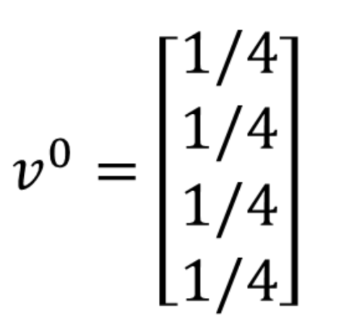
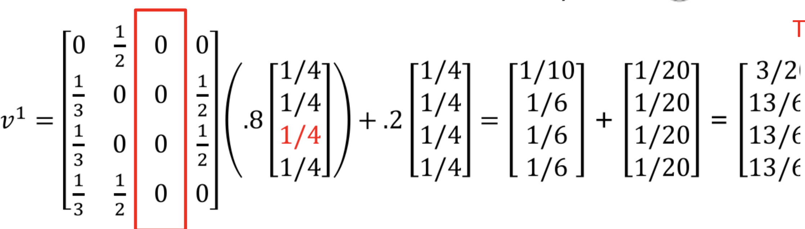
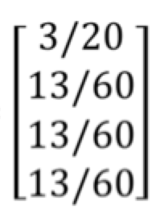
Taxation on Dead End (and others)
Total = 1
Total: 48/60
Loss: 8/10 * 1/4 + 2/10 *1 – 2/10 *1 = 1/5 = 12/60 (lost)
sink on c
tax on all
teleport (gain)

Slide 19
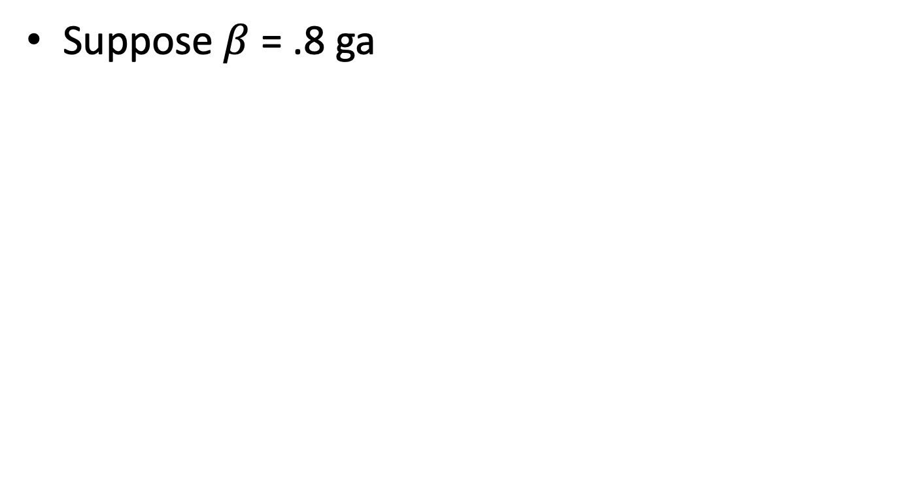
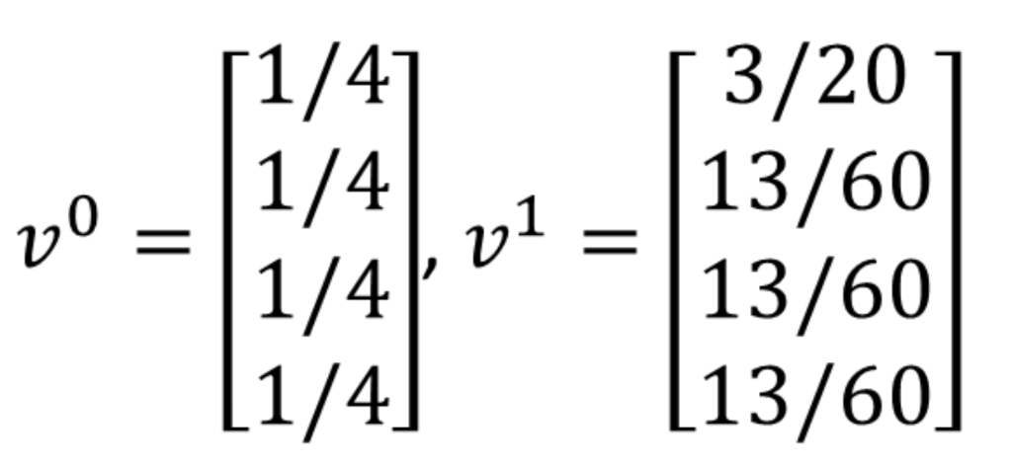
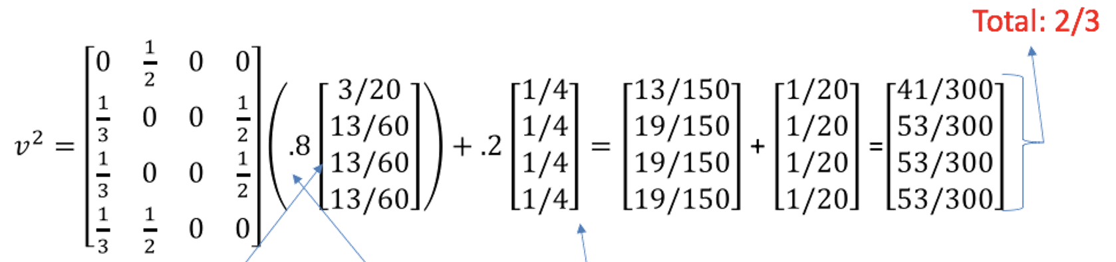
Taxation on Dead End (and others)
Total = 1
Total = 48/60=4/5
sink on C
tax on all
teleport gain
Net loss in this step: 0.8*13/60 + 0.2*48/60 – 0.2*1 = 13/75 + 4/25 – 1/5 = 2/15
Total loss (step 2 and 1): 2/15 + 1/5 = 1/3

Slide 20
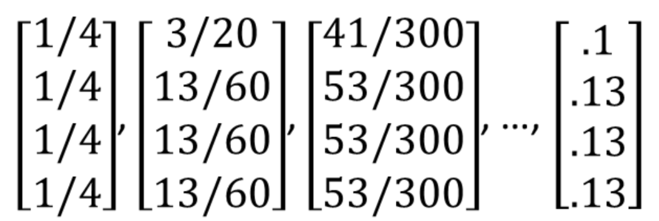
After 100 Iterations
Net loss = column 2 + column 3 – column 4
Remaining: 1 4/5 2/3 .49
At the end of iteration # | Loss due to dead end | Loss due to taxation (20% tax) | Gain due to teleporting | Net loss in step | Total loss in all steps | Remaining ranks
1 | 8/10 * 1/4 | 2/10 * 1 | 2/10 * 1 | 1/5 (.2) | 1/5 (.2) | 4/5
2 | 8/10 * 13/60 | 2/10 * 4/5 | 2/10 * 1 | 2/15 (.13) | 1/5+2/15 (.33) | 2/3
… | … | … | … | … | … | …
Net loss in step will be zero when loss and gain balance out

Slide 21
Without taxation (continuously sink)
At the end of iteration # | Lost Prob. | Total loss | Remaining
1 | 1/4 (.25) | 1/4 (.25) | 3/4
2 | 5/24 (.21) | 1/4 + 5/24 = 11/24 (.45) | 1-11/24 =13/24
3 | 7/48 (.15) | 11/24+7/48 =29/48 (.6) | 1-29/48 =19/48
… | … | … | …
With taxation
At the end of iteration # | Loss due to dead end | Loss due to taxation (20% tax) | Gain due to teleporting | Net loss in a step | Total loss in all steps | Remaining ranks
1 | 8/10 * 1/4 | 2/10 * 1 | 2/10 * 1 | 1/5 (.2) | 1/5 (.2) | 4/5
2 | 8/10 * 13/60 | 2/10 * 4/5 | 2/10 * 1 | 2/15 (.13) | 1/5+2/15 (.3) | 2/3
… | … | … | … | … | … | …
Net loss will be zero when loss and gain balance out

Slide 22
Why Do Teleports Solve the Problem?
Why are dead-ends and spider traps a problem and why do teleports solve the problem?
Spider-traps
PageRank scores are not what we want
Solution: Never get stuck in a spider trap by teleporting out of it in a finite number of steps
Dead-ends
The matrix is not column stochastic so our initial assumptions are not met
Solution: Make matrix column stochastic by always teleporting when there is nowhere else to go

Slide 23
Alternative for Dealing with dead-ends
Prune and propagate
Preprocess the graph to eliminate dead-ends
This may create new dead-ends
Might require multiple passes
Compute pagerank on reduced graph
Approximate values for dead-ends by propagating values from reduced graph

Slide 24
How is Pagerank Information Used in a Search Engine?
Each search engine has a secret formula that decides the order in which to show pages to a user in response to a search query
Google: thought to use over 250 different properties of pages
Search engine decides on a linear order of search results
To be considered for ranking, page has to have at least one of the query search terms
Unless all search terms are present, little chance of being in top ten results
Among qualified pages, score computed for each
PageRank is an important component of the score
Other components: presence/absence of search terms in headers, links to the page
Notes:
2018 summer 2.1

Slide 25
PageRank Iteration using MapReduce
If n is small enough that each Map task can store the full vector v and v′ in main memory
With additional steps to multiply each component of Mv by constant β and to add (1−β)/n
Given the size of the Web, v is much too large to fit in main memory
Break M into vertical stripes (chp. 2.3.1) and break v into corresponding horizontal stripes to execute the MapReduce

Slide 26
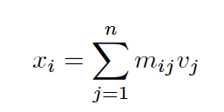
Matrix-Vector Multiplication by MapReduce
Matrix M of size n*n, vector v of length n
M v = x
the vector x of length n, whose i_{th} element x_{i} is given by

Slide 27
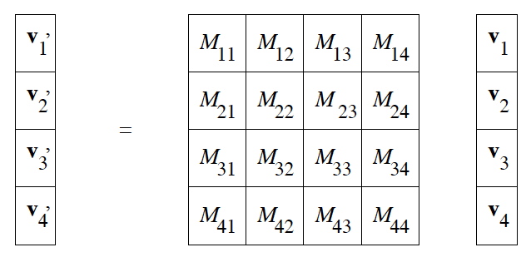
Use of Combiners to Consolidate the Result Vector
Partition the vector v into k stripes and matrix into k² blocks
E.g., k=4

Slide 28
Use of Combiners to Consolidate the Result Vector (Cont’d)
Use k² Map tasks (e.g., 16)
Each task gets one square of the matrix M (M_{ij}) and one stripe of the vector v (v_{j})
each stripe of the vector is sent to k (e.g., 4) different Map tasks
v_{j} is sent to the task handling M_{ij} for each of the k possible values of i
Advantage: keep both the j_{th} stripe of v and the i_{th} stripe of v′ in main memory as we process M_{ij}
Note that all terms generated from M_{ij} and v_{j} contribute to v′_{i} and no other stripe of v′

Slide 29
PageRank Iteration Using MapReduce
Assume rank vector v does not fit in main memory
Block stripe update method: break M into vertical stripes and break r into corresponding horizontal stripes
Allows us to execute MapReduce efficiently
Process no more of v at any one Map task than can fit in main memory
Trying to use a combiner gets more complicated: Section 5.2.3
Partition matrix M into k² blocks, vector r in k stripes
Use k² Map tasks
Each Map task gets: one square of matrix: M_{ij}, one stripe of vector, r_{j}
Each stripe r_{j} sent to k Map tasks, transmitted over network k times
But each M_{ij} transmitted only once

Slide 30
Some Problems with Page Rank
Measures generic popularity of a page
Biased against topic-specific authorities
Solution: Topic-Specific PageRank
Susceptible to Link spam
Artificial link topographies created in order to boost page rank
Solution: TrustRank
Uses a single measure of importance
Other models of importance
Solution: Hubs-and-Authorities

Slide 31
Topic-Specific PageRank
Notes:
2019 w1.2

Slide 32
Topic-Specific PageRank
Instead of generic popularity, can we measure popularity within a topic?
Goal: Evaluate Web pages not just according to their popularity, but by how close they are to a particular topic, e.g. “sports” or “history”
Allows search queries to be answered based on interests of the user
Example: Query “Trojan” wants different pages depending on whether you are interested in sports, history, and computer security

Slide 33
Topic-Specific PageRank
Random walker has a small probability of teleporting at any step
Where a Teleport can go:
Standard PageRank: Any page with equal probability
Topic Specific PageRank: A topic-specific set of “relevant” pages (teleport set)
Idea: Bias the random walk
When walker teleports, she picks a page from a set S
S contains only pages that are relevant to the topic
E.g., Open Directory (DMOZ) pages for a given topic/query
For each teleport set S, we get a different vector r_{S}

Slide 34
Discover Topic PageRank Vectors r_{s} for Topic Set S
If the search engine can deduce the user’s interests, then it can do a better job of returning relevant pages
A private PageRank vector that gives importance of each page to that user (not feasible!)
Topic-Sensitive PageRank: creates one vector for some small number of topics
Bias PageRank to favor pages of that topic
Create different PageRank vectors for different topics
The 16 top-level categories of the Open Directory (DMOZ): arts, business, sports,…
If we can determine that the user is interested in one of these topics (e.g., by content of pages they recently viewed), use the PageRank vector for that topic when deciding on ranking of pages for query results

Slide 35
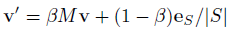
Biased Random Walk
Bias toward a set S of pages
S called teleport set
e_{S}: a vector with 1 for pages in S, 0 otherwise
Notes:
2017 1.2

Slide 36
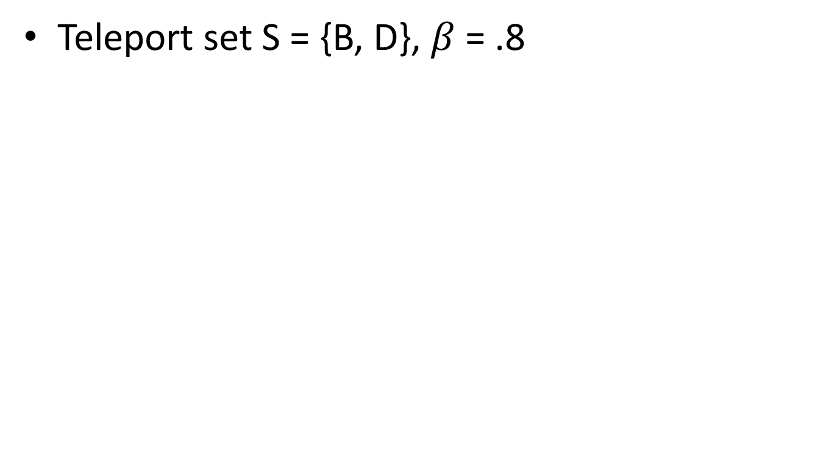
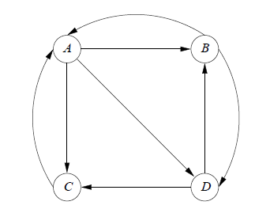
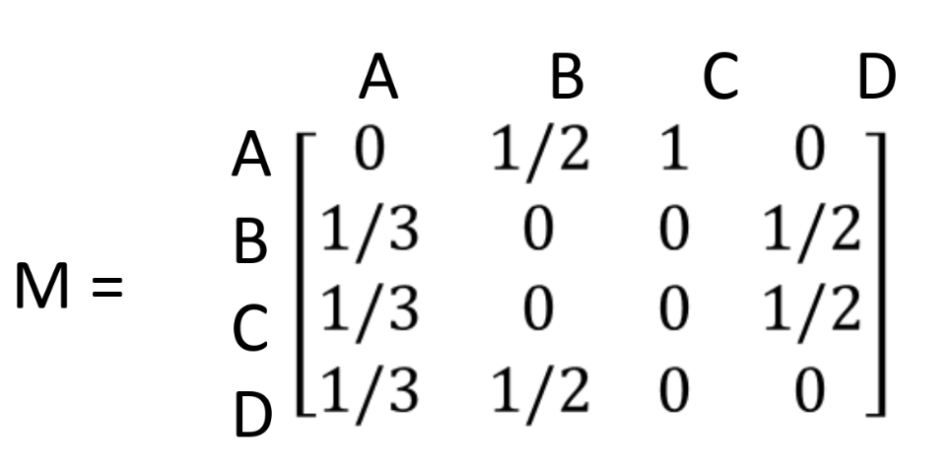
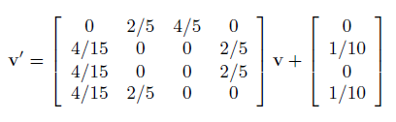
Example
0.2 * 1/2
Notes:
S = [1,1,0,1]
|S| = 3
es = [1/3,1/3,0,1/3]
Beta * es = (1-0.8)[...]

Slide 37
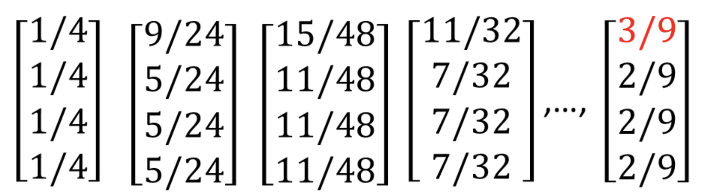
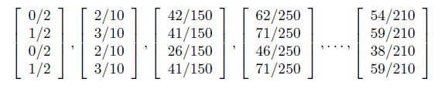
Example
Unbiased: A has the largest
Biased: B and D has largest PageRanks

Slide 38
Integrating Topic-Sensitive PageRank Into a Search Engine
Decide on topics for which to create specialized PageRank vectors
Pick a teleport set for each of these topics
Use that set to compute topic-sensitive PageRank for that topic
Determine the topic or set of topics most relevant to a particular search query
More on this in next slide
Use the PageRank vector for those topic(s) to order the responses to the search query

Slide 39
How to Select the Topic Set that is Most Relevant to the Search Query?
Tricky
Several methods proposed:
User can pick from a topic menu
Infer the topic(s) from the context of the query
Words that appear in Web pages recently searched by user or recent user queries
E.g., query is launched from a web page talking about a known topic
History of queries: e.g., “basketball” followed by “Kobe”
Classification of documents by topic: studied for decades
Infer the topic(s) from information about the user
E.g., the user’s bookmarks, their interest on Facebook, etc.
Notes:
2018 w1.2

Slide 40
TrustRank: Combating Web Spam

Slide 41
What is Web Spam?
Spamming:
Deliberate action to boost a webpage’s position in search results
Not commensurate with page’s real value
This is a very broad definition
SEO industry might disagree!
SEO = search engine optimization
Approximately 10-15% of web pages are spam

Slide 42
Web Search
Early search engines:
Crawl the Web
Index pages by words they contained
Respond to search queries (lists of words) with the pages containing those words
Early page ranking:
Attempt to order pages matching a search query by “importance”
First search engines considered:
(1) Number of times query words appeared
(2) Prominence of word position, e.g. title, header

Slide 43
First Spammers: Term Spam
How do you make your page appear to be about movies?
(1) Add the word “movie” 1,000 times to your page
Set text color to the background color, so only search engines would see it
(2) Or, run the query “movie” on your target search engine
See what page came first in the listings
Copy it into your page, make it “invisible”
These and similar techniques are called term spam
Notes:
Do not forget to tell the joke "I used to do this when I was young" when talking about point (1) :D

Slide 44
Google’s Solution to Term Spam
Believe what people say about you, rather than what you say about yourself
Use words in the anchor text (words that appear underlined to represent the link) and its surrounding text
PageRank as a tool to measure the “importance” of Web pages
Doesn’t depend on content of pages

Slide 45
Why It Works?
Our hypothetical shirt-seller loses
Saying he is about “movies” doesn’t help, because others don’t say he is about movies
His page isn’t very important, so it won’t be ranked high for shirts or movies
Example:
Shirt-seller creates 1,000 pages, each links to his with “movie” in the anchor text
These pages have no links in, so they get little PageRank
So the shirt-seller can’t beat truly important movie pages, like IMDB

Slide 46

Google vs. Spammers: Round 2!
Once Google became the dominant search engine, spammers began to work out ways to fool Google
Spam farms were developed to concentrate PageRank on a single page
Link spam:
Creating link structures that boost PageRank of a particular page

Slide 47
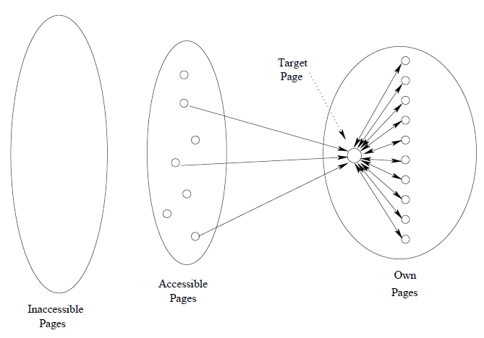
Spam Farm
at which the spammer
attempts to place as much PageRank as possible
supporting pages
the pages that the spammer owns and controls
those pages that, while they are not controlled by the spammer, can be affected by the spammer.
the pages that the spammer cannot affect. Most of
the Web is in this part
Notes:
Leave comments in forums (accessible pages) that contain links to supporting pages

Slide 48
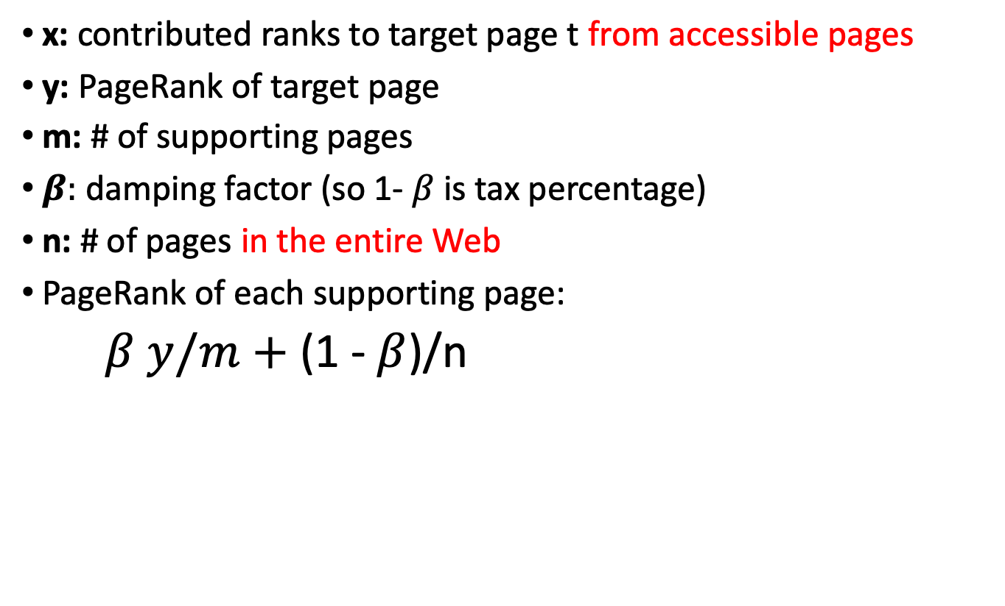
Spam Farm Analysis

Slide 49
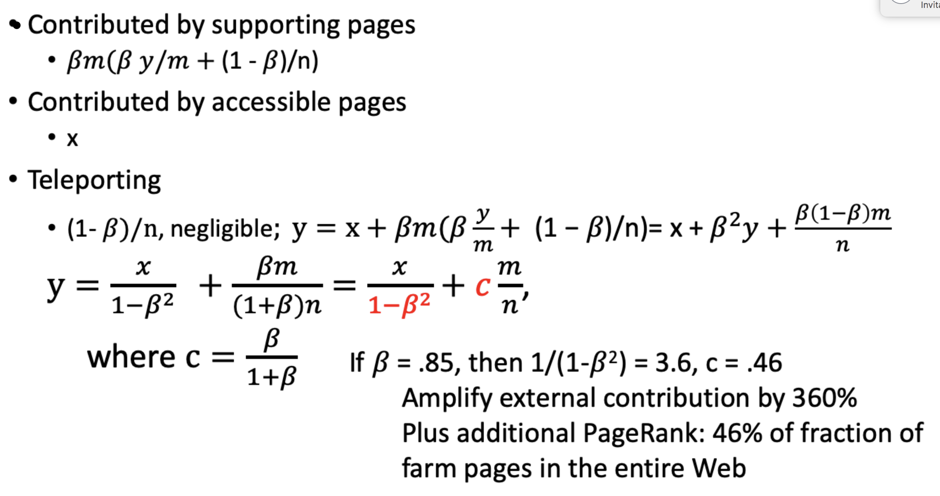
Compute PageRank of Target Page

Slide 50
HITS: Hubs and Authorities

Slide 51
HITS Ideas
A variant of topic-sensitive PageRank
Topic = a set of trustworthy pages
Identify trustworthy pages
Manually examine pages with high Page Ranks
Pick pages within controlled domains: edu, gov, mil
Avoid borderline pages, e.g., blog sites, forums

Slide 52
HITS Algorithm
Hyperlink-induced topic search
Each page has two scores
Hub: does it provide many pointers to the topic?
Authority: how important the page is about topic?
Examples
Hub: department pages listing all courses
Authority: individual course pages

Slide 53
Authority and Hub
A good authority page is one
pointed by many good hub pages
A good hub page is one
pointing to many good authority pages
U
X
authority
hub
Y
V
A
B
W
Z

Slide 54
Computing Authority and Hubbiness
Authority of a page =
sum of hubbiness of pages pointing to it
a(A) = h(U) + h(V) + h(W)
Hubbiness of a page =
sum of authority of pages it points to
h(B) = a(X) + a(Y) + a(Z)
U
X
authority
hub
Y
V
A
B
W
Z

Slide 55
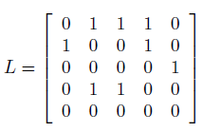
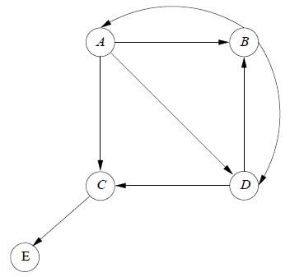
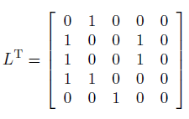
Link Matrix
L[i,j] = 1 if there is a link from node i to node j
L^{T} is the un-normalized M in PageRank
A
A

Slide 56
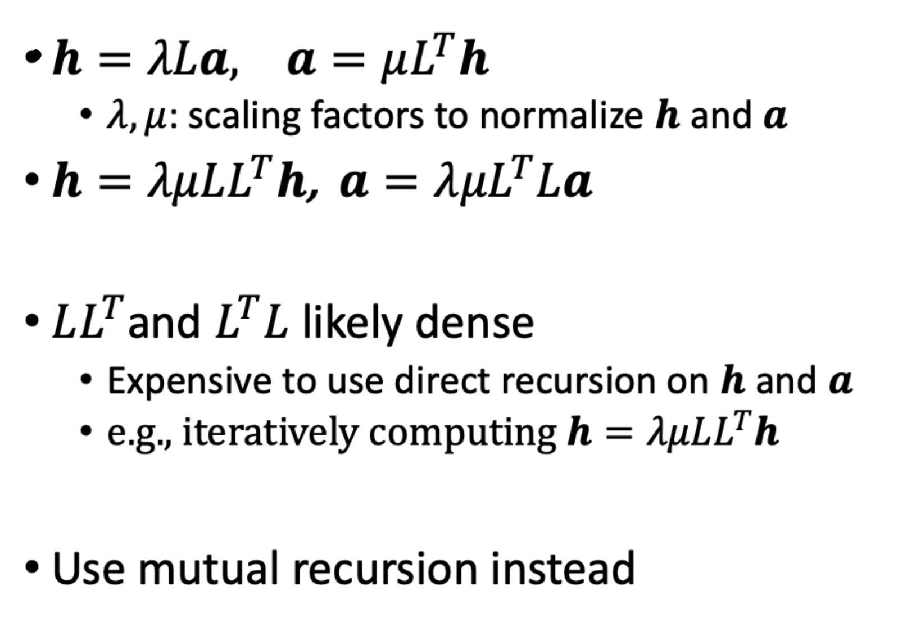
Computing Authority and Hubbiness

Slide 57
Compute via Mutual Recursion
Start with h = a vector of all 1’s
Compute a = L^{T}h, then scale it so that largest component is 1
Compute h = La and similarly scaled
Repeat steps 2 and 3 until h and a do not change much

Slide 58
Bipartite View of Iterations
Compute authority from hub
A
A
B
B
C
C
D
D
E
E
Compute hub from authority
Hub
Authority

Slide 59
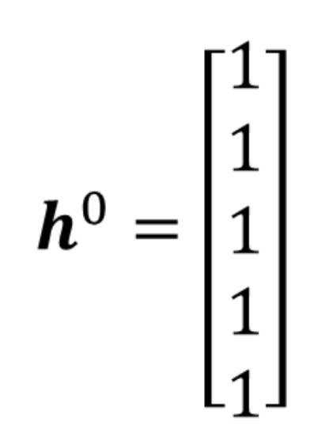
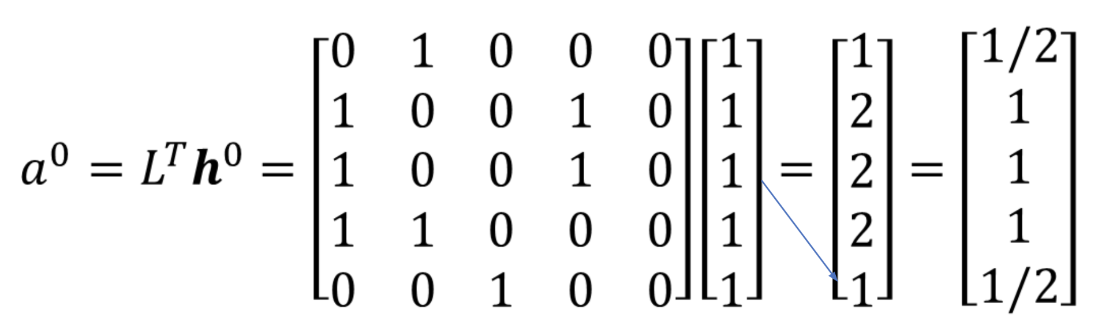
Example
C’s hub = E’s authority
Can you predict the changes to hub scores next?

Slide 60
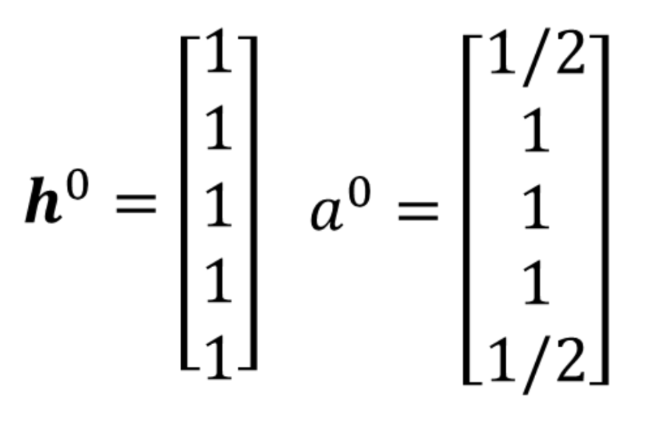
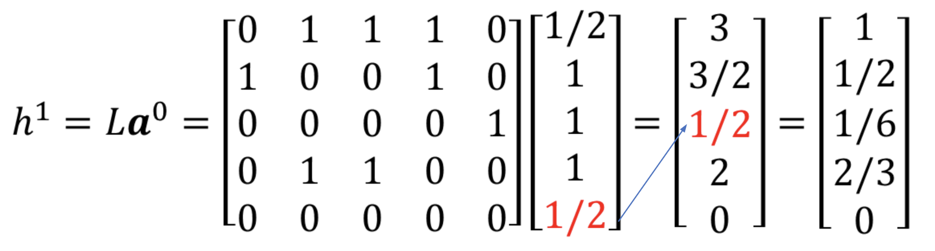
Example
C’s hub = E’s authority
Will E’s authority decrease? Will E have > 0 hub score?
Notes:
E’s authority = C’s hub

Slide 61
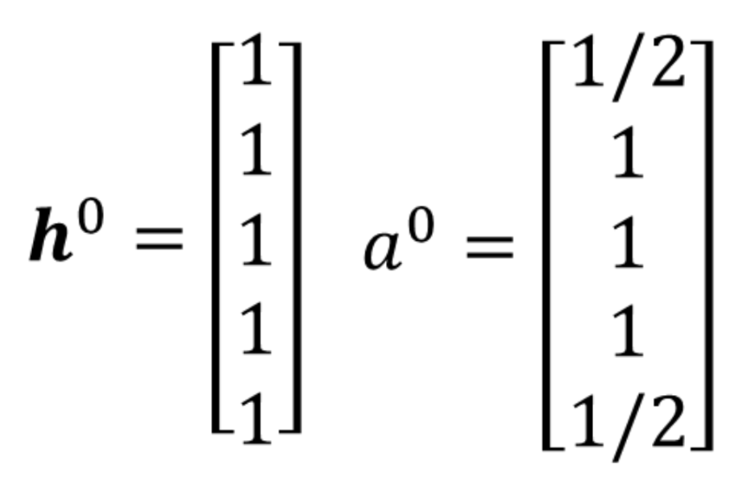
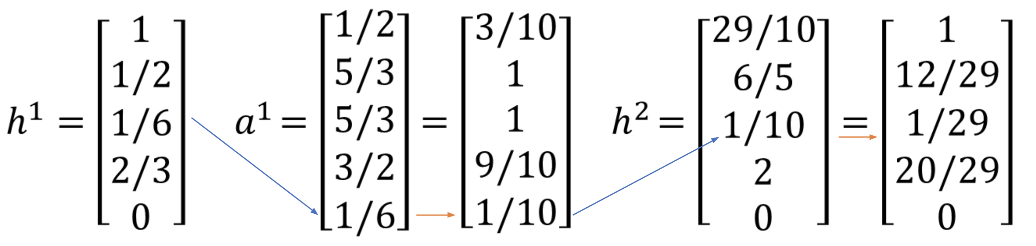
Example
C’s hub=E’s authority
Decrease due to normalization

Slide 62


Example
C’s hub=E’s authority
Decrease due to normalization

Slide 63

At the Limit
A: greatest hub
B, C: greatest authority

Slide 64
PageRank and HITS
PageRank and HITS are two solutions to the same problem
Rank the relative value of pages
Use these values in search engine algorithms to determine the order of search results

